Slide 1
Flow control Statements
Conditional Statements.
Looping statements
Transfer/Jump statements

Slide 2
Conditional Statements
If Statement.
Nested if statement.
If-else statement.
If-else-If statement.

Slide 3
Looping Statements
For Loop
While Loop
Do while Loop.
Enhanced For Loop

Slide 4
Transfer Statements
Break.
Continue.

Slide 5
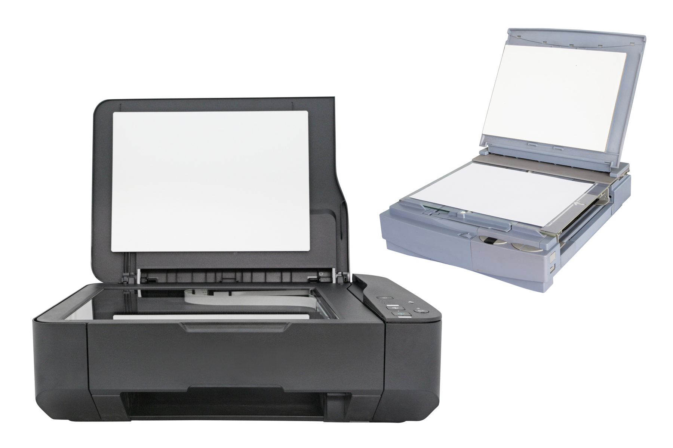
Scanner class

